Slide 1

ASYNCHRONOUS TASK

Slide 2
Introduction
An asynchronous task refers to a programming paradigm where tasks are executed independently and concurrently, without blocking the execution of the main program or other tasks.
In other words, asynchronous tasks allow a program to continue running while certain operations are being performed in the background.

Slide 3
Introduction
This "Asynchronous Task Project" is an Android application that showcases the implementation of two asynchronous tasks: the "Moving Banner" and the "Calculator.“
Asynchronous programming addresses this issue by decoupling tasks and allowing them to run concurrently. Instead of waiting for a task to complete, the program can initiate a task and continue executing other tasks or operations without interruption.

Slide 4

OBJECTIVE OF THE PROJECT
The objective of this project is to provide a concise analysis of the implementation and benefits of asynchronous tasks in Android app development, using the "Moving Banner" and "Calculator" functionalities as practical examples.
The "Calculator" app demonstrates asynchronous tasks for performing calculations on random inputs.
When the user calculates, a random input is generated, and an AsyncTask executes the calculation

Slide 5
OBJECTIVE OF THE PROJECT
The "Moving Banner" app demonstrates asynchronous tasks in Android by implementing a scrolling banner.
When the user starts the task, the banner message continuously moves from right to left.
The "Stop Task" button allows the user to halt the scrolling of the banner message. The banner message in the app is "Demonstration of Asynchronous Task."

Slide 6
IMPLEMENTATION
The "Moving Banner" task demonstrates how to create a continuous scrolling effect for a banner message.
When the user presses the "Start Task" button, the banner message, initially set as "Demonstration of Asynchronous Task," will continuously scroll from right to left.
This scrolling functionality is achieved using an AsyncTask, which runs in the background and updates the UI with the new banner message periodically.
Pressing the "Stop Task" button will stop the scrolling animation and freeze the banner message.

Slide 7
IMPLEMENTATION
The "Calculator" task showcases the use of asynchronous tasks for performing calculations on random inputs.
When the user presses the "Calculate" button, a random input is generated, and an AsyncTask is executed to perform the calculation.
The calculation process simulates a time-consuming task, and the result is displayed once the task completes.
This asynchronous approach ensures that the calculation does not block the main thread, allowing the application to remain responsive.

Slide 8
OUTCOME OF THE PROJECT
The expected outcome of the "Moving Banner" application is a functional Android application that demonstrates the use of asynchronous tasks to create a moving banner effect.
The application will feature a user-friendly interface with two buttons: "Start Task" and "Stop Task".
Upon pressing the "Start Task" button, the banner message "Demonstration of Asynchronous Task" will scroll continuously from right to left.
Pressing the "Stop Task" button will halt the scrolling animation.

Slide 9
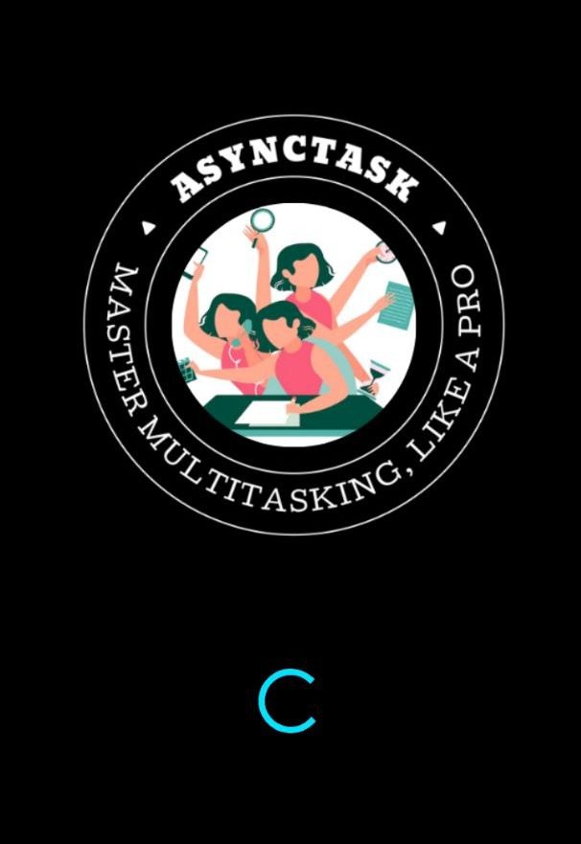
RESULT SCREENSHOTS
SPLASH SCREEN

Slide 10
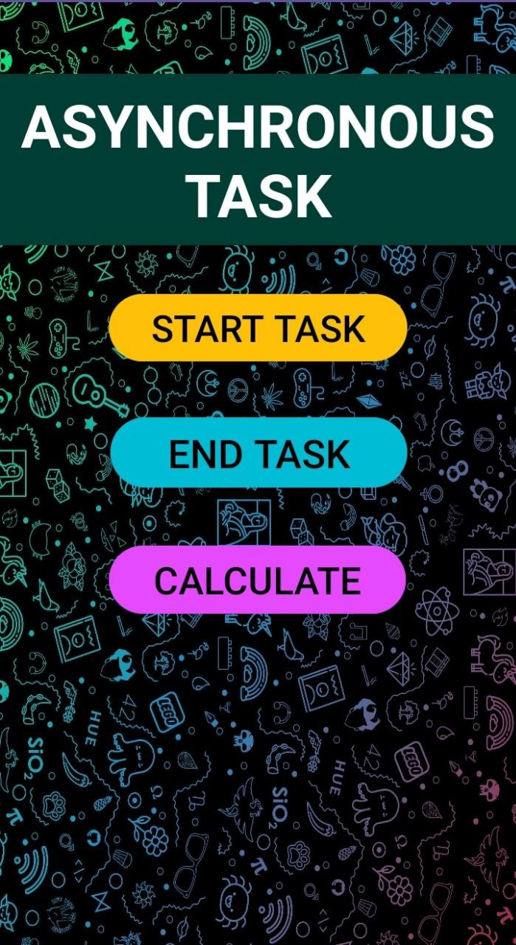
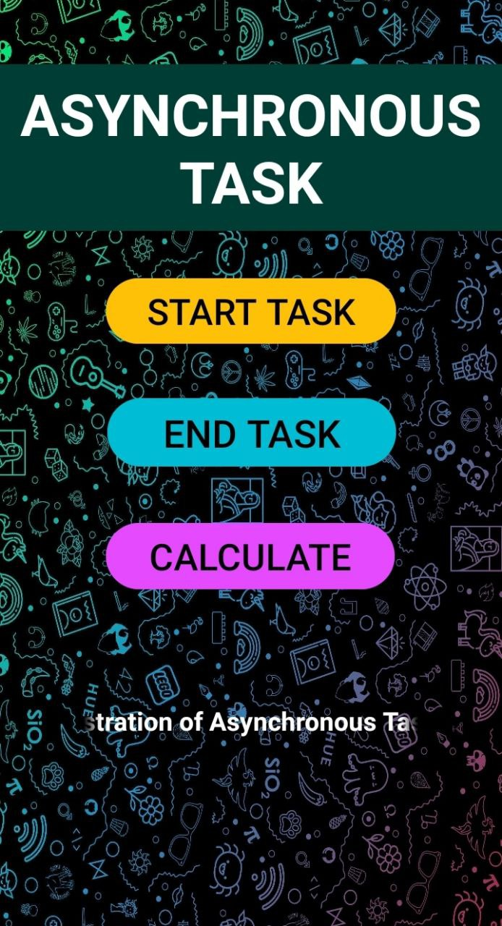
RESULT SCREENSHOTS

Slide 11
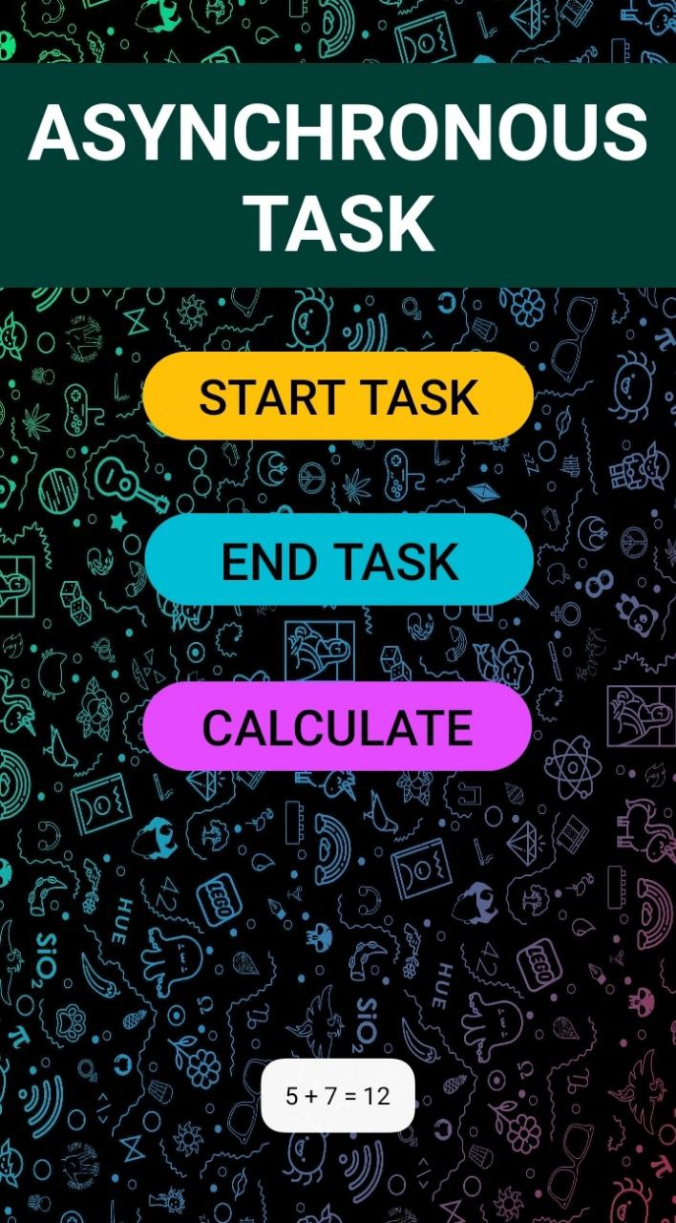
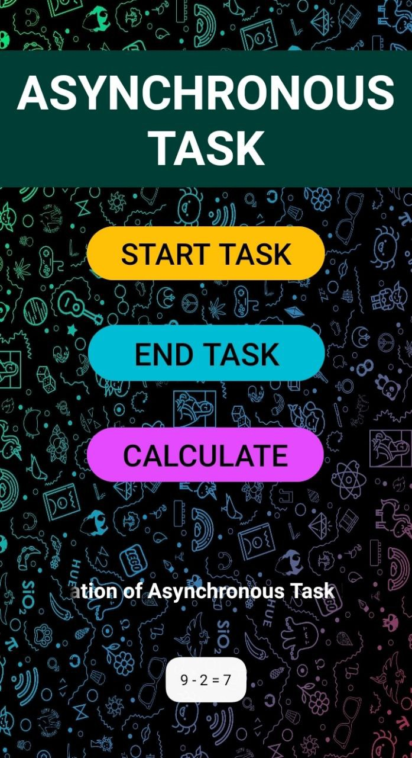
RESULT SCREENSHOTS

Slide 12


